Slide 1

DEPARTMENT OF COMPUTER ENGINEERING, MODELING, ELECTRONICS AND SYSTEM ENGINEERING LM-Telecommunication Engineering: Smart Sensing, Computing and Networking Network Aspect of Internet of Things Project Title: Smart Environment Monitoring and Control System
Implemented by:
Rami Saleh Hussein Mohammed

Slide 2
introduction
Problem Statement:
Air quality and climate conditions need monitoring and control for health and comfort.
Manual monitoring is inefficient and time-consuming.
Solution:
An IoT-based system to monitor air quality, temperature, and humidity.
Automatically control actuators (Fan and Window) based on sensors data.
Store data in the cloud for future analysis and send alerts by Email or SMS message when the values exceeds the thresholds.

Slide 3
System Components
Sensors: MQ-2 (Gas), DHT11 (Temperature and Humidity).
Actuators: Fan, Servo Motor (Window).
Microcontrollers: ESP32 (x3) , ESP8266 (x1).
Central Hub: Raspberry Pi 3.
Cloud: Amazon Web Service (AWS)
AWS IOT Core service : Acts as the primary interface for managing sensor data and sending actuator commands.
Lambda service : Processes incoming data and send it to Dynamo DB, and triggers notifications via SNS.
Dynamo DB service : Stores real-time sensor data for structured querying and analysis.
SNS service : Sends alerts when environmental thresholds are exceeded.
Communications:
Bluetooth (MQ-2 sensor, Fan).
MQTT over Wi-Fi (DHT11 sensor, Servo Motor).

Slide 4
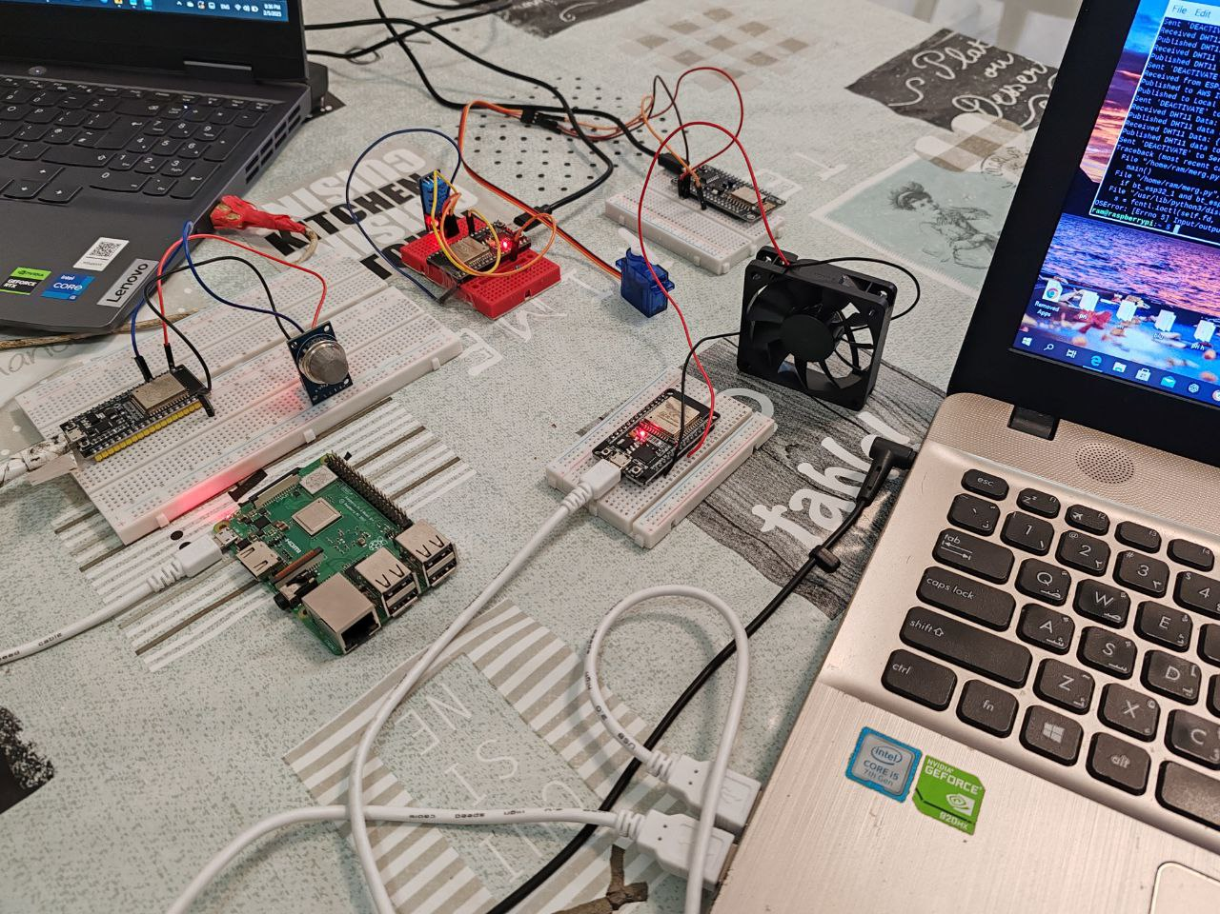
Hardware Components

Slide 5
Working Principle
Email
Notifications
Project Plan :
AWS
ESP32 (MQ-2 sensor)
ESP32
(DHT11 sensor)
All Data
Temperature & Humidity
Gas Level
Raspberry Pi
Wi-Fi
Bluetooth
ESP32 (Fan actuator)
ESP8266 (Window actuator)
Control Commands
Control Commands

Slide 6
Working Principle
The project consist of four parts :
Data sending part
The first ESP32 send the DHT11 sensor data (Temperature and Humidity) via MQTT over Wi-Fi to the Raspberry pi.
The second ESP32 send the MQ-2 gas sensor data (Gas level) via Bluetooth to the Raspberry pi.
Data processing part (Central Node)
The Raspberry pi receives data sent via Bluetooth and Wi-Fi and does two things :
Sends (Publish) the data to the AWS cloud.
Compares the values received with the thresholds to send control commands to the controllers connected to the actuators.
If Temperature or Humidity value exceeds the threshold the Raspberry pi sent active command via MQTT over Wi-Fi to the ESP8826 to Turn on the Window (servo motor).
If Gas level value exceeds the threshold, the Raspberry pi sent active (ON) command via Bluetooth to the ESP32 to turn on the Fan.

Slide 7
Working Principle
The project consist of four parts :
3. Control command reception part
There are two controllers :
The ESP8826 receives the control commands from the Raspberry pi via MQTT over Wi-Fi to control the Window (Servo).
The ESP32 receives the control commands from the Raspberry pi via Bluetooth to control the Fan.
4. AWS Cloud part
The Raspberry pi sends the data to the AWS IOT Core service via MQTT over Wi-Fi.
The AWS IOT Core trigger the Lambda service
The Lambda service does :
Send data to the Dynamo DB service for storage.
Send alerts through SNS service when the values exceed the thresholds.
The SNS service sends alerts by Email.

Slide 8
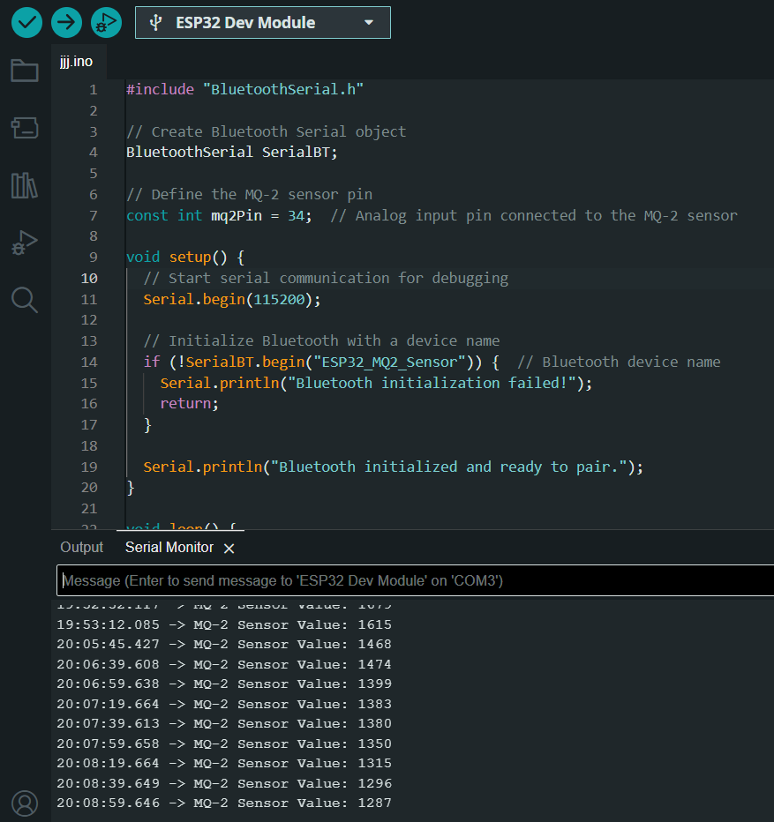
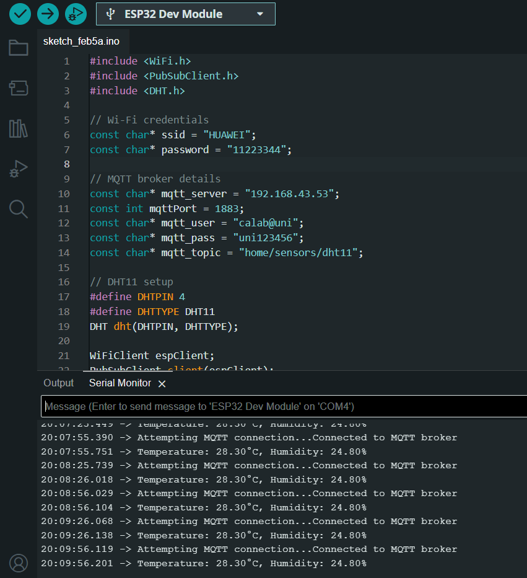
Working Principle
in first figure the ESP32 sends Gas level value through Bluetooth to the Raspberry pi,
in second figure the ESP32 sends Temperature and Humidity values through Wi-Fi to the Raspberry pi

Slide 9
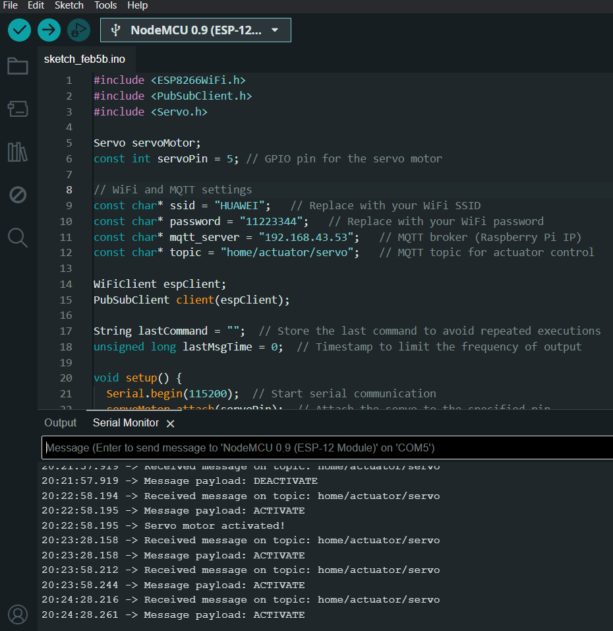
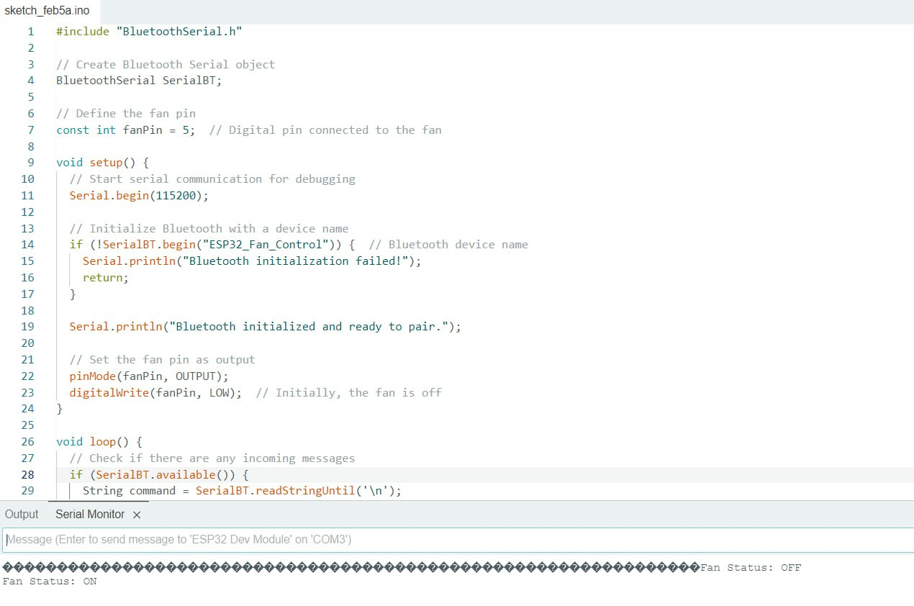
Working Principle
in the first figure the ESP8266 receives control commands from the Raspberry pi through Wi-Fi,
in the second figure the ESP32 receives control commands from the Raspberry pi through Bluetooth.

Slide 10
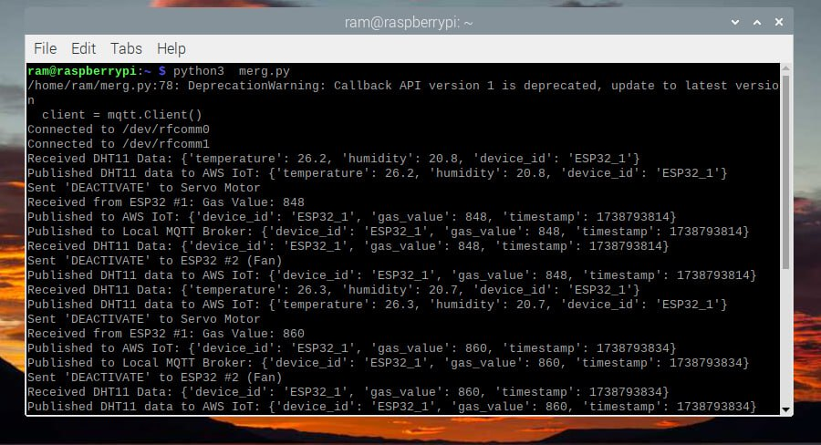
Working Principle
in the Figure the Raspberry pi receives the Temperature and Humidity through MQTT over Wi-Fi and Gas Levels through Bluetooth, and based on the thresholds in python code , the raspberry pi sends control commands to actuators (one via MQTT over Wi-Fi and other via Bluetooth.

Slide 11
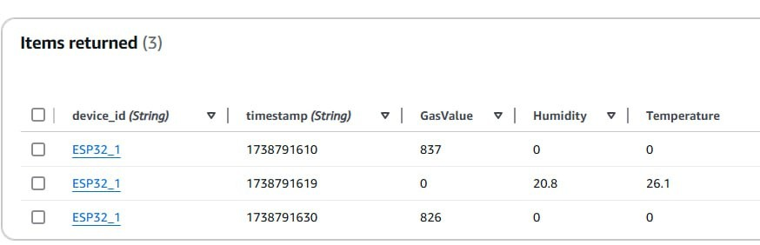
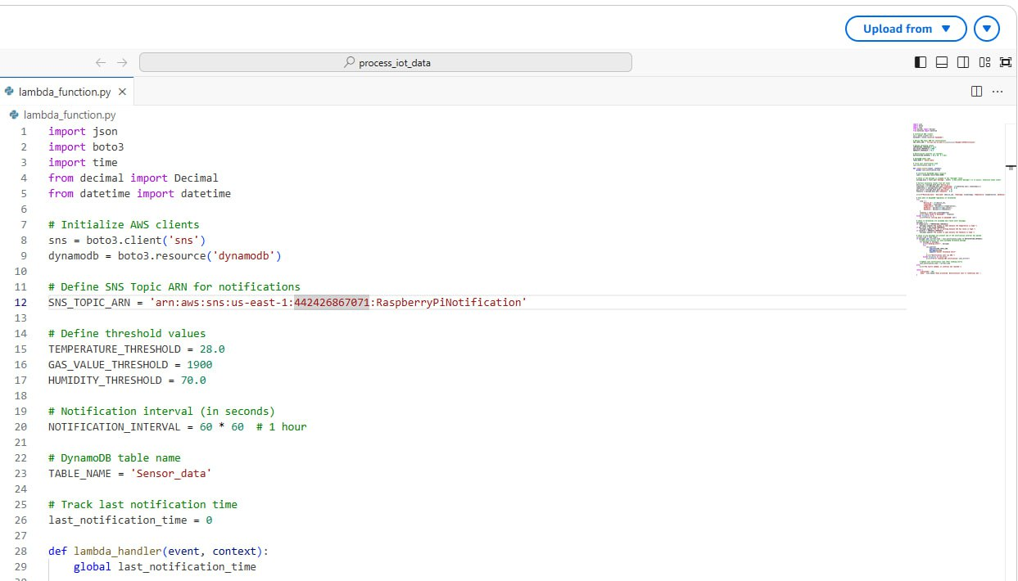
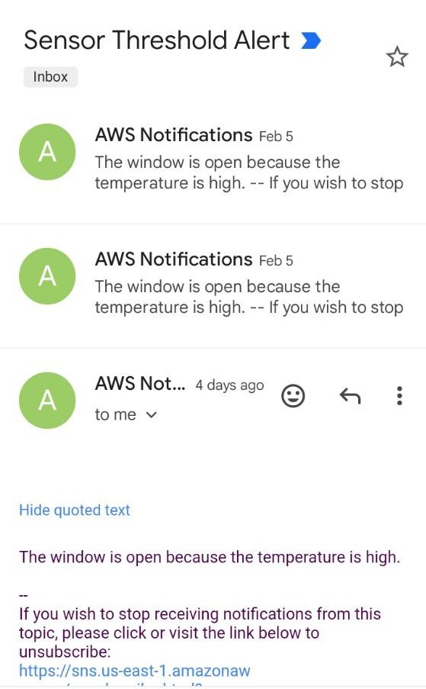
Working Principle
in AWS : the first figure represents the Lambda service code that processes the incoming data from the
raspberry pi, and the second figure represents Dynamo DB service and data storage, the third figure is
represents the Alerts sent via Email.

Slide 12
Features
Real-time monitoring of gas levels, temperature, and humidity.
Automated control of fans and windows based on sensor data.
Alerts via email if thresholds are exceeded.
Data storage in the cloud for historical analysis.
Scalable and modular design for future enhancements.

Slide 13
Future Enhancements
Integrate more sensors (e.g., CO2, PM2.5).
Implement a mobile application for remote monitoring.
Use machine learning for predictive analysis.

Slide 14
Conclusion
The project demonstrates a practical IoT-based solution for environmental monitoring and control.
It ensures a healthy and comfortable environment by automating air quality and climate regulation.
The system is scalable, cost-effective, and can be adapted for various applications.

Slide 15
Thank you very much

